Slide 1
Quantum Computing Architectures (EE274) Lecture 14
Hiu-Yung Wong
Mar. 11, 2025
hiuyung.wong@sjsu.edu, Office: ENG363
http://www.sjsu.edu/people/hiuyung.wong/index.html

Slide 2

Outline
Spin: Rabi Oscillation with Rotating Magnetic Field
Spin Qubit
Midterm Next Week: Cover all materials up to this week. 1 letter-size cheat sheet (double-sided).
Some hints:
Basic concepts of quantum computing, measurement
Quantum Circuit and Matrix multiplications
Density Matrix and Paul Vectors
Quantum Gates, Larmor Precession and Rabi Oscillations

Slide 3
Rabi Oscillation under a rotating magnetic field
Chapter 10 of “Quantum Computing Architecture and Hardware for Engineers: Step by Step”
This part has a lot of maths. You only need to be able to understand and derive them open-book (e.g. for assignment). But you need to understand what I am doing.

Slide 4
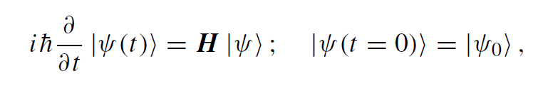
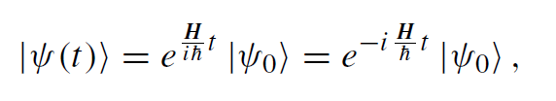
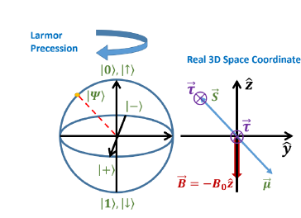
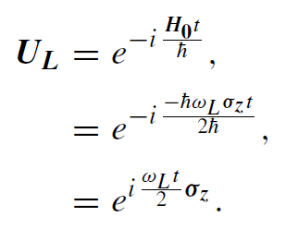
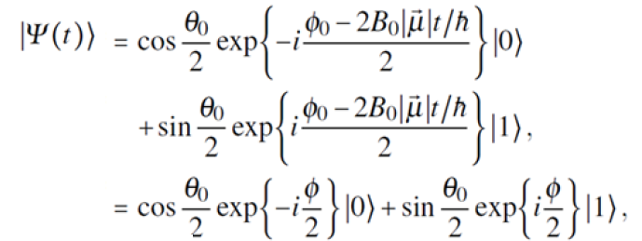
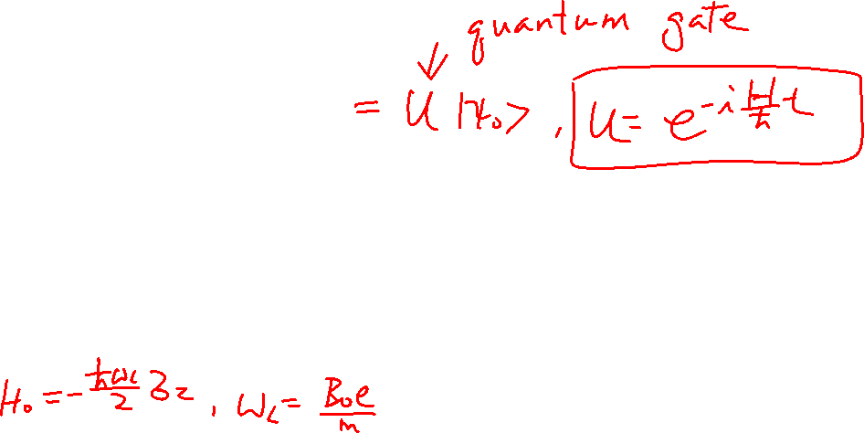
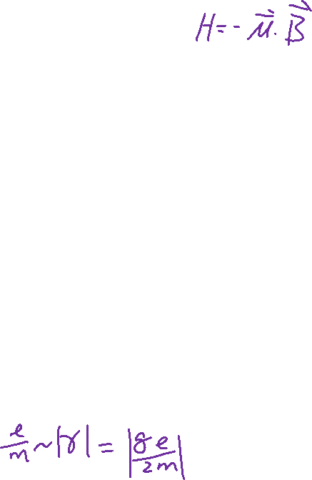
Quantum Gate and Hamiltonian
From the Last Lecture
General Solution to S.E.
Example: for Larmor Precession:
Recall:

Slide 5

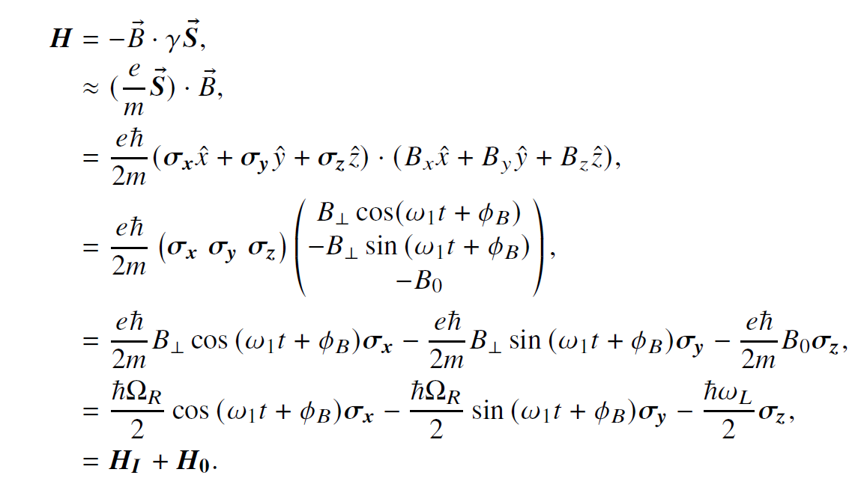
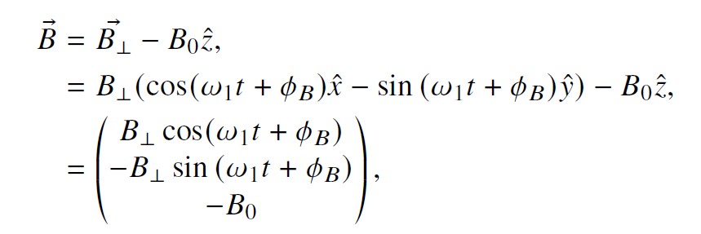
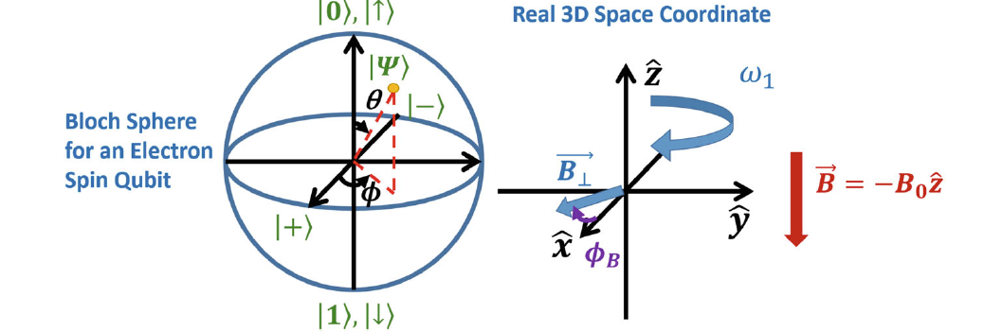

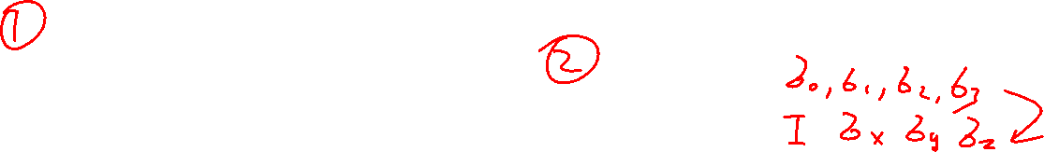
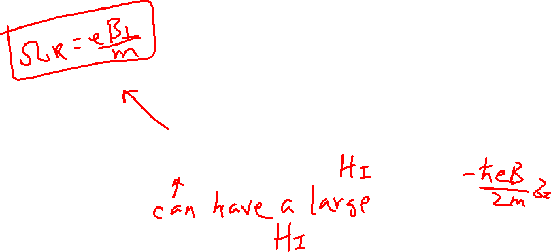
Rabi Oscillation with Rotating Magnetic Field
From the Last Lecture
Learning outcomes: Able to write the Hamiltonian

Slide 6
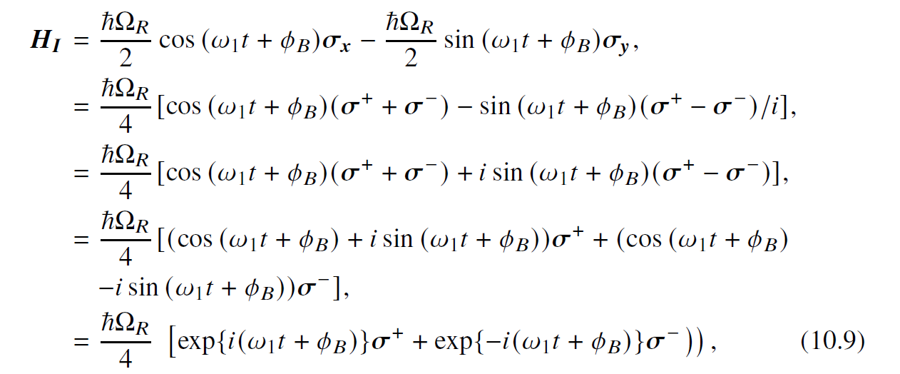
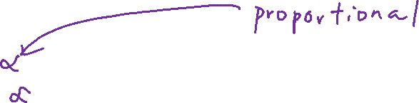
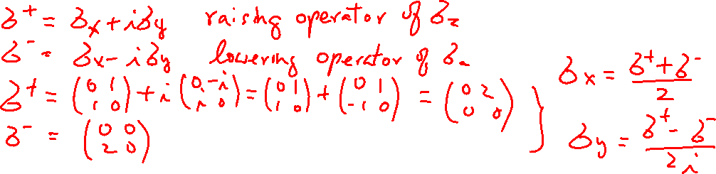
Rabi Oscillation with Rotating Magnetic Field Raising and Lowering Operators
From the Last Lecture
Learning outcomes: Able to write the Hamiltonian

Slide 7
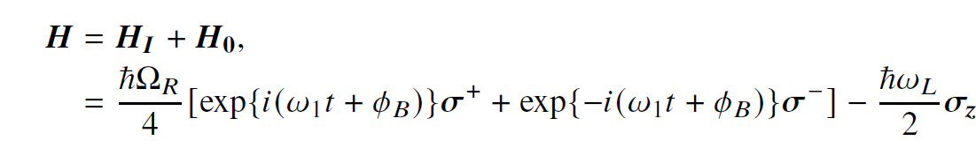
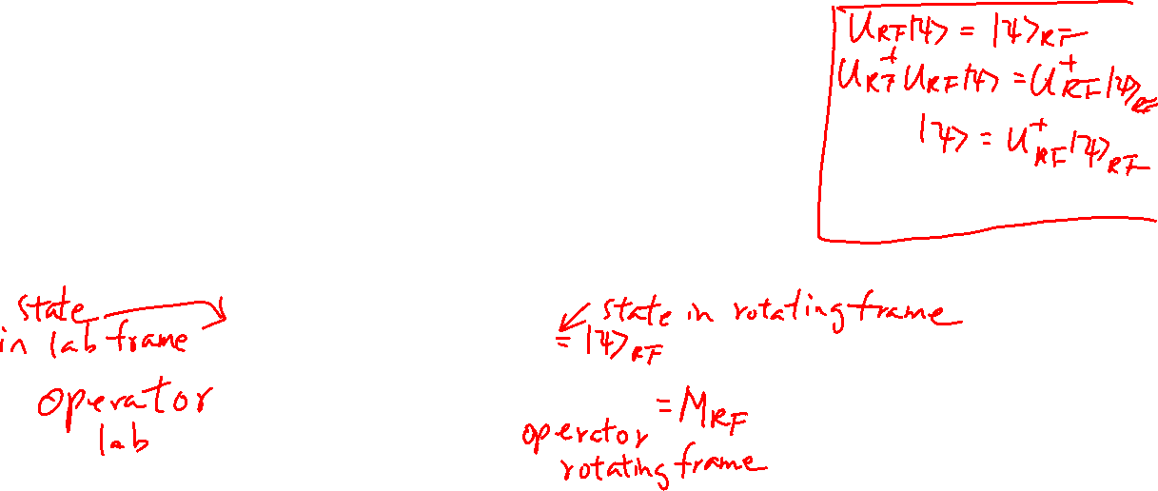
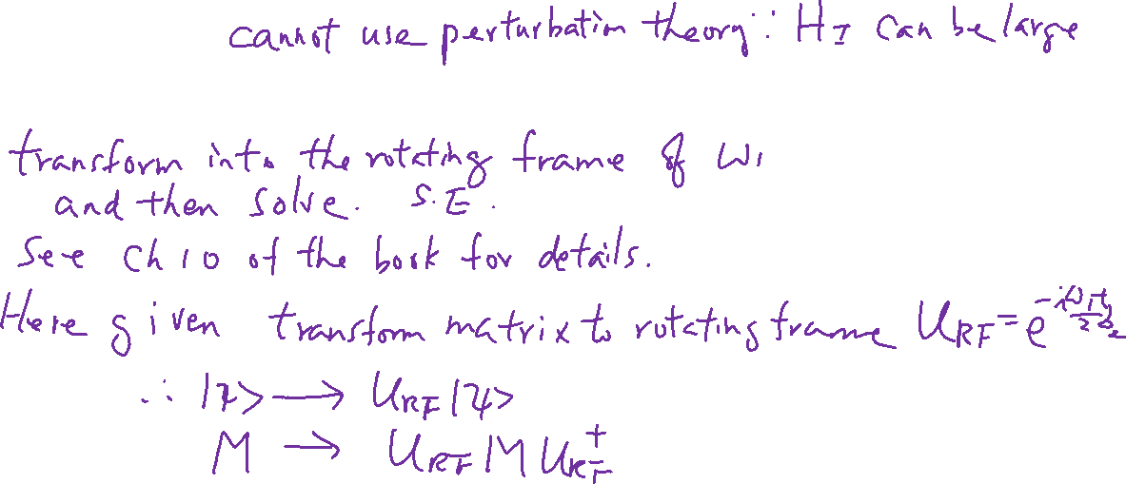
Rotating Frame (no RWA)
Learning outcomes: Know how to do transformation
From the Last Lecture

Slide 8
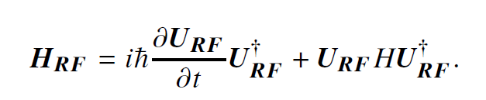
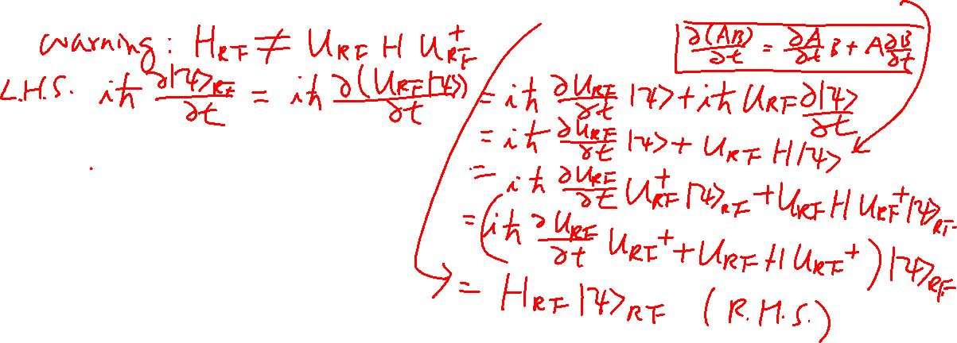
Rotating Frame (no RWA) Express Hamiltonian in the Rotating Frame
Learning outcomes: Know how to do transformation

Slide 9
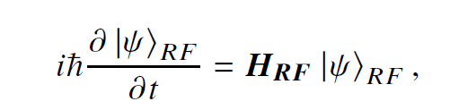
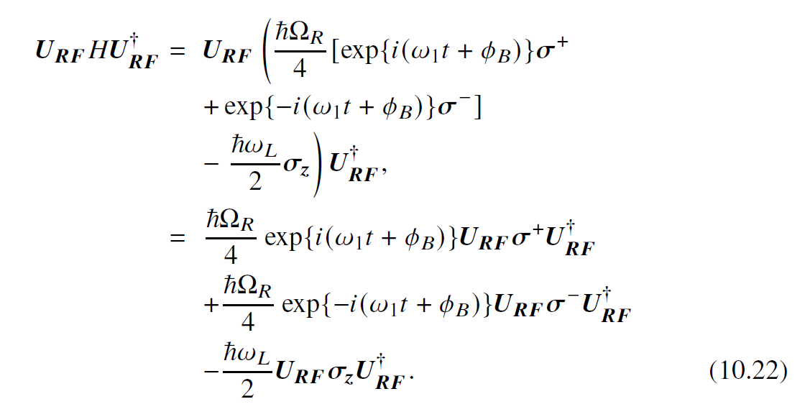
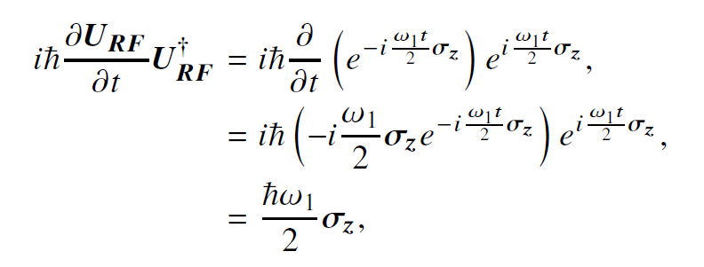
Rotating Frame (no RWA) Express Hamiltonian in the Rotating Frame
Learning outcomes: Know how to do transformation
1st term
2nd term

Slide 10
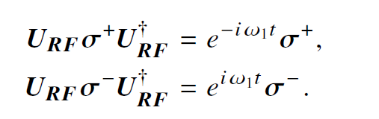
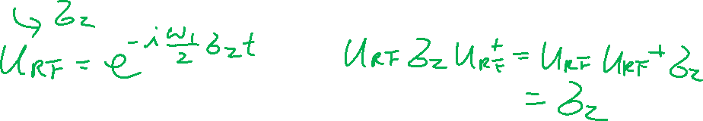
Rotating Frame (no RWA) Express Hamiltonian in the Rotating Frame
Learning outcomes: Know how to do transformation
2nd term
See chapter 10 or prove yourself.

Slide 11
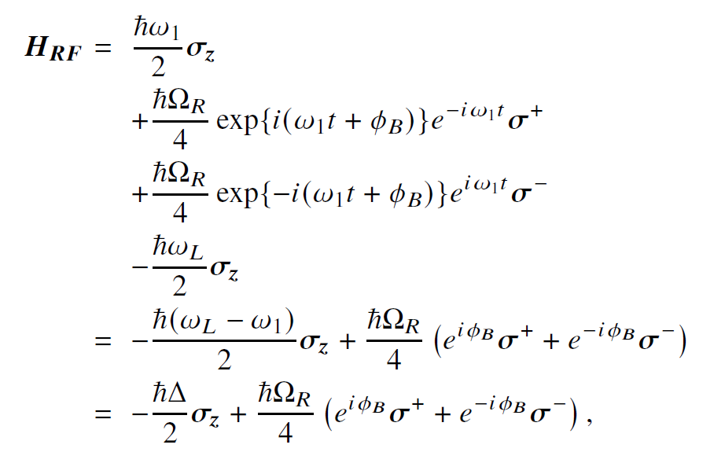
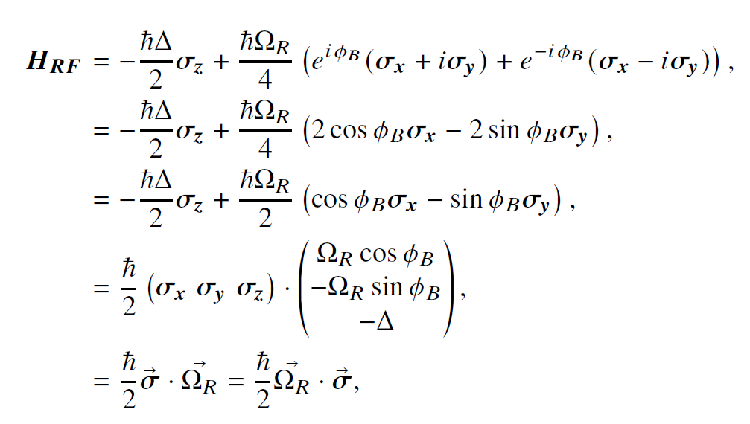
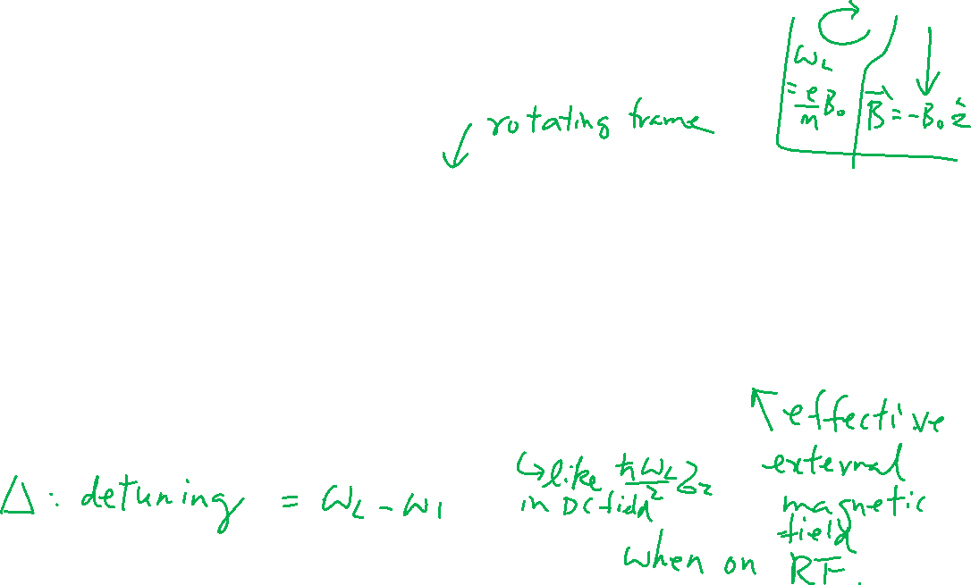
Rotating Frame (no RWA) Express Hamiltonian in the Rotating Frame
Learning outcomes: Know how to do transformation

Slide 12
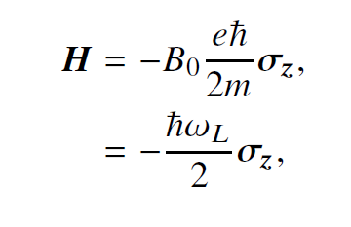

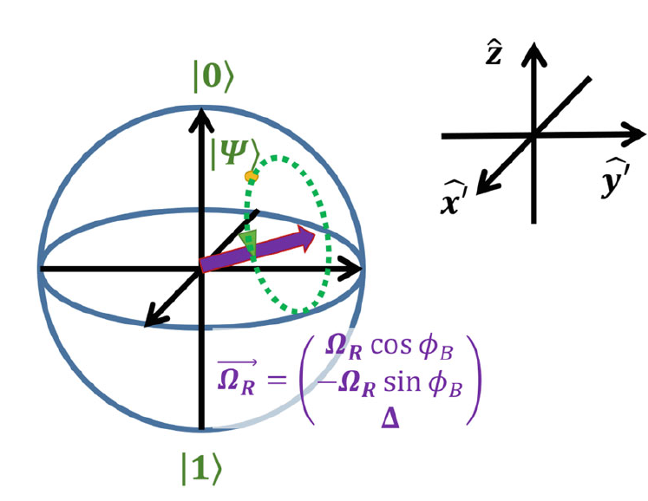
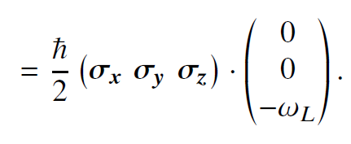
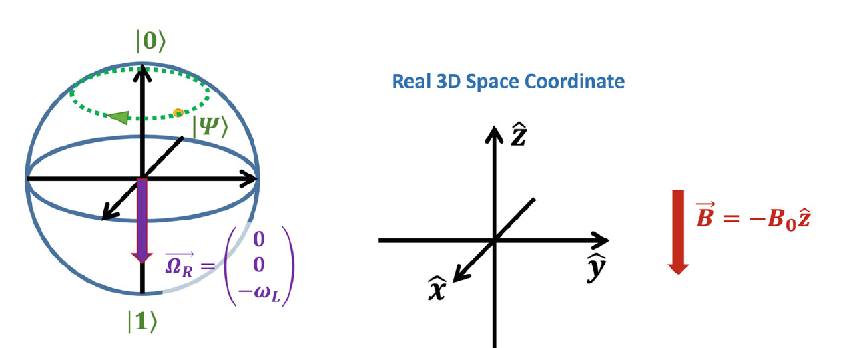
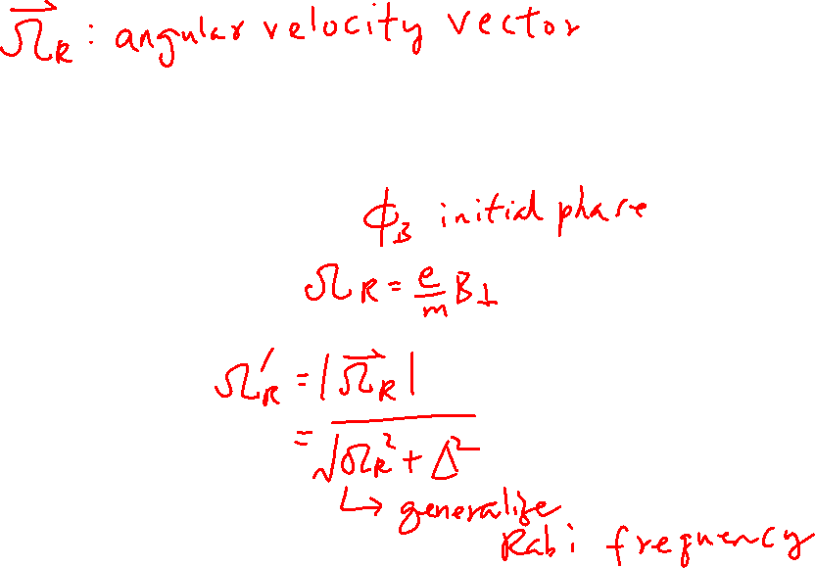
Final Results (We don’t solve it here)
Learning outcomes: Understand the results and able to plot on Bloch Sphere
Recall:
Now

Slide 13
Spin Qubit Quantum Computer
Chapters 11 and 12 of “Quantum Computing Architecture and Hardware for Engineers: Step by Step”
This part has a lot of maths. You only need to be able to understand and derive them open-book (e.g. for assignment). But you need to understand what I am doing.

Slide 14
DiVincenzo's criteria for QC
5 Necessary Criteria for quantum computing:
A scalable physical system with well characterized qubit (system needs to remain in the subspace of 2 level)
The ability to initialize the state of the qubits to a simple fiducial state (initialization time is important)
Long relevant decoherence times (much longer than gate time)
A "universal" set of quantum gates
A qubit-specific measurement capability (Some algorithms only works without measuring all qubits at the same time e.g. teleportation)
2 Necessary Criteria for quantum communication:
The ability to interconvert stationary and flying qubits (even one bit stationary and one bit flying)
The ability to faithfully transmit flying qubits between specified locations (without decoherence)

Slide 15
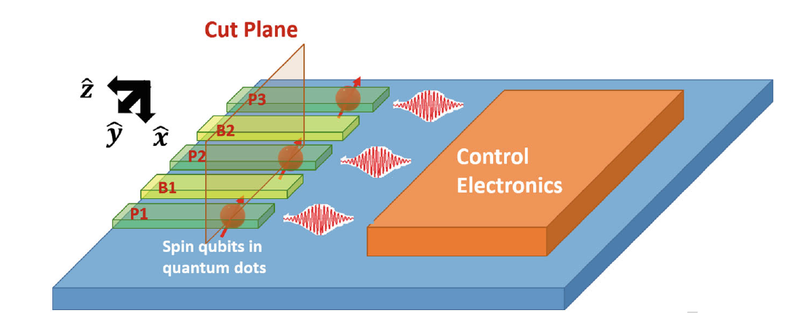
Why Silicon Spin Qubits
Learning outcomes: Understand why Si Qubit is promising
Quantum Error Correction is one of the most promising way to protect the qubit
Likely, need 1000 physical qubits to form a robust logical qubit
For complex quantum algorithm, thousands of logical qubit are required => millions of physical qubits
Quantum processors likely needs to integrate with classical processors
Si qubit is the most promising from the integration perspective
Spin in electron
Spin in nucleus

Slide 16
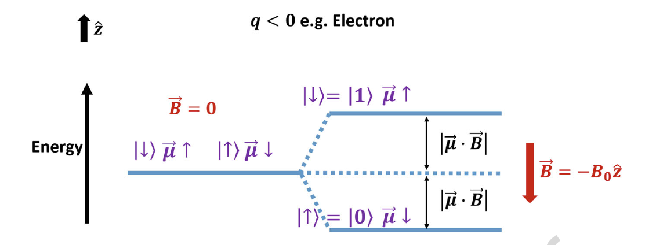
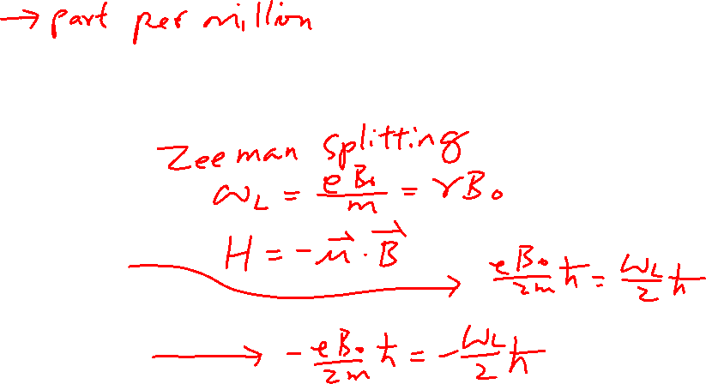
Properties of Si Spin-Qubit
²⁸Si with no nuclear spin is used. Natural Si has 5% ²⁹Si. (Need to purify to 800ppm)
Magnetic field: 1.4T
Temperature: 50mK
T₂*=120us (without Echo)

Slide 17
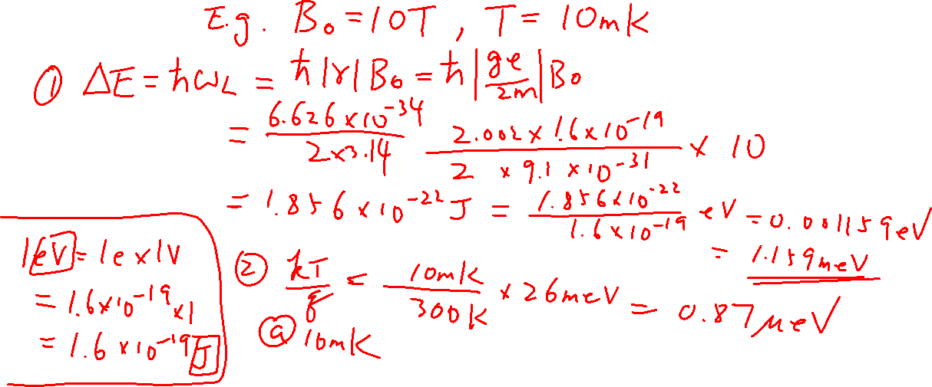
Sidenote: Calculation of Zeeman Splitting (Is it a good 2-level system compared to the thermal energy?)

